Slide 1
Active Systems Monitoring & Maintenance
- Improving Data Availability, Integrity, and Security
- Reducing support call volumes
- Improving reimbursements
- Helping care givers focus on what is important: their patients!
Presented by Scott A. White – MCPM, Information Systems – Saratoga Hospital
& Director of Operations at EVTF.org - over two decades of hands on Healthcare and I.T.

Slide 2
Why monitor and maintain the core systems that your clinicians rely on to care for their patients?
Active monitoring & maintenance of these systems will identify and mitigate problems before they are noticed by the clinicians. If left unmanaged, these issues usually surface in the patient care areas and contribute to the delay in patient care. When monitoring & maintenance are not performed with great regularity, we find ourselves being called for support on issues after the clinicians run into problems. These “touch points” also contribute to your compliance with HIPAA 800-32 and 800-34 for Data Availability, Integrity, and Security. Being proactive with this approach will reduce support calls, improve the reliability of the systems, increase end user adoption, and ultimately help improve patient care. Yes, help improve patient care – because if downed systems, hung sessions, locked jobs, clogged queues, and missing data contribute to negative patient outcomes, then the inverse must also be true.

Slide 3
- It’s all about “DATA”
OK – so we all know that healthcare services isn’t really ALL about data; but from an I.T. perspective, we can make a difference in patient outcomes and the hospital’s bottom line.
From the perspective of Improved Patient Care, Quality Measures, Meaningful Use, the Two Midnight Rule, DSRIP, etc., we all need to devote the right resources to monitor & maintain our DATA and it’s infrastructure.

Slide 4
- Improves Data Availability, Integrity,
and Security
*Hung processes, invalid locks, and over-taxed resources make records inaccessible. Records that are not accessible often lead to alternate processes or manual work-arounds. This compromises the integrity of the full record or care.
*Identification of data errors through the DBA and Error checks can catch these in advance instead of going undetected until years later.
* Scanning for “un-encrypted sessions”, high volume failed log in attempts, and supporting access needs during off-hours will reduce shared acct. access and allow you to address a security risk in real-time.

Slide 5
- Reduces support call volumes
* Proactive identification of these events and the ability to address them before the end-user reaches the tipping point.
* Crashed sessions, extended log-in periods where the clinician left hours ago, session mobility, stalled background jobs, IST issues, Print queues, etc.. lead up to clinicians calling for help.
* If your off-hours support model uses your day-shift I.T. staff as On-call, then your clinicians have a natural “wait” built into their support needs. You can eliminate at least ½ the support calls for system issues by monitoring & maintaining these processes.

Slide 6
- Improves Reimbursement
* A 2015 CIO forum post included an AHA cart demonstrating the losses in reimbursement to healthcare organizations and how they are tied to data management & utilization.
* Delays in patient care, missing documentation, I.S. doesn’t match S.I. (intensity of service / Severity of Illness), under-coding due to lack of supporting information, etc..
* Crashed jobs that feed your billing & claims processes will generate delays and missed records. These delays can contribute to “untimely filing” denials for payment and billing errors that generate red-flags, audits, and rework.

Slide 7
- General points
Locks- Just like the door to your home, a lock is not necessarily a bad thing. Some locks are valid and intentional and should be left alone until cleared by a normal process. However, if you are viewing the locks within any application and notice that the records are not indexing (changing) then you may have an issue with this lock. Locks in general, should not extend beyond an 8 hour shift. If they are, then they are suspect and should warrant further investigation. Most valid locks last a few minutes; but I wouldn’t get excited about one that is behind for 30 minutes as it is not uncommon for a clinician to be working on a record for that long.
Midnight run- Generally speaking, this is the sign of a healthy close of day and the start of the next 24 hour clock. It is a good practice to benchmark how long each of them usually takes to complete. If you know what a normal midnight run duration is, then you’ll be able to connect the dots when certain jobs appear to be lagging behind or simply missing data. In rare cases, you might even notice that a midnight run had never completed – time for a little investigatory work.
Background jobs- Imagine a fence between two adjoining yards. You and your neighbor share gardening tools and set up a process that involves placing the tools on top of the fence when you are done with them so the other person can grab them and use them next. If my neighbor places the item on the fence, then their process is working fine; but that does not mean that I necessarily took the item off the fence for my use. That is my background process and now my garden will show signs that I did not use this item. Just as a patient record sent from ADM to PHA, does not mean PHA picked it up for use within its tables. So check both application’s background jobs for activity when you see something, or in this case, don’t see it. The mere act of signing into an application will sometimes start a stalled background job. Have you ever seen the temporary error message “Can’t access application from this segment”? Then try again and it is fine. For a clinician, it is another error to deal with and perhaps get sidetracked; but to I.S. it is a normal part of systems monitoring & maintenance and should trigger a deeper look into integrated/interfaced processes.
Print processes- Some application specific print queue managers allow manipulation of the print-job’s destination or status. Some allow holding, halting, or cancelling, and some just allow you to list what is currently in the queue. In general, viewing these processes with sufficient frequency will help you see if bottlenecks exist, problematic printers need attention, or in some cases, where there are wasted jobs & resources to clean up. Paper-less EMR is a myth; but less-paper EMR processes are not. We still print wrist-bands, specimen labels, work-lists, and patient discharge packets.

Slide 8
Show of hands in the audience-
How many of you have a daily operations check list that you believe someone has
on their “to-do list”; but you don’t think they actually do it every day without fail?
How many of you believe that list does NOT contain all of the essential check points
necessary to ensure optimal performance of your Meditech systems?
How many of you have written scripts or use other automated tools to monitor
these systems; but the notifications only go to an on-call person?
How many of you just wait until you come in the next day and walk into
these little “love notes” from Caretaker or other systems?
…and how many of you are losing sleep because you are the one who remotes in
at night and weekends to check on all of these?

Slide 9
A comprehensive outline of available tools within your core applications merged with real world / practical explanations.
This systems focused review is utilized in Best Practice IT Shops across the globe.
If you know these things happen from time to time and they impact the required flow of timely data, then sweeping for them several times a shift and correcting them WILL PREVENT many of the common system issues that contribute to delays in patient care.

Slide 10
A quick check list of the 70+ items reviewed at least twice per shift at our hospital.
Some items have their own automated “reporting”, some are done manually, and others through scripting. Regardless of the method, trained staff need to respond and mitigate.

Slide 11
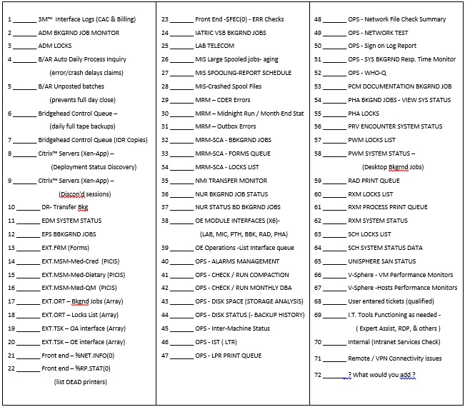

Slide 12
Meditech MAGIC OPS Maintenance Routines
OPS- Main Menu screen is our initial stop:
– One of the first indicators that we see in OPS is the Alarms count that is displayed on the MAIN OPS Menu. Every Meditech installation comes pre-loaded with standard Alarm conditions that will trigger a message. Fortunately, you can also customize the threshold on most activity so that you can trend and catch them before they are actually on fire. We’ve set thresholds to warn us of approaching dangerously low available disk space, disconnected interfaces, multiple attempts of a bad sign-on, etc. We do this through the Manage Caretaker Text Capture Dictionary. This improves the advanced notification of those run-a-way jobs or custom NPRs with Slash-variables that gobble of free space within minutes. It makes it a lot easier to triage a support call where someone is having trouble logging in; but does not know the name of their device or User.ID. It also helps identify attempts to log into the system with false credentials.

Slide 13
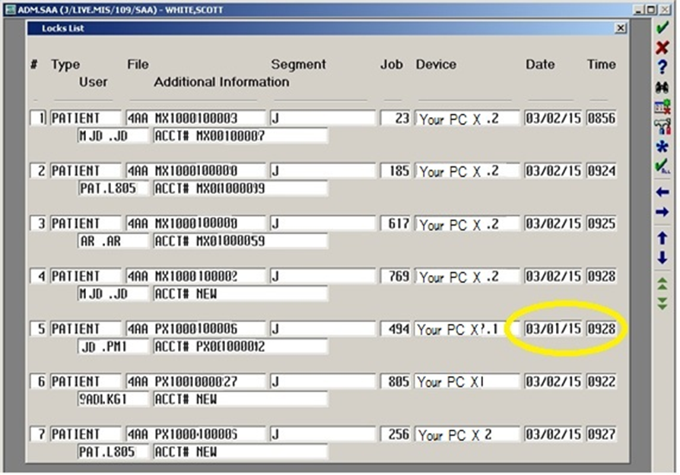
Managing ADM Locks:
– The ADM Locks routine is a good tool for catching those lost or crashed jobs that create locks on records as well as troubleshooting calls after the fact. As seen in the example below, there are several “valid locks” which are a natural part of the patient access routines. Some locks are healthy, in that they are LIVE jobs where the record is in use and should not be terminated. However, in the circled example below which shows a locked job that is approximately 24 hours old, it is best to clear this lock preemptively to prevent problems for the next person that needs to use this record downstream. The benefits to doing this are: reliable access for the next person on this record, one less overnight phone call to I.T. support because of a locked record, increased confidence in the systems by the end users, reduced costs when you aren’t forced to touch the same record dozens of times due to these errors, and your I.T. teams ability to avoid these unplanned distractions.

Slide 14
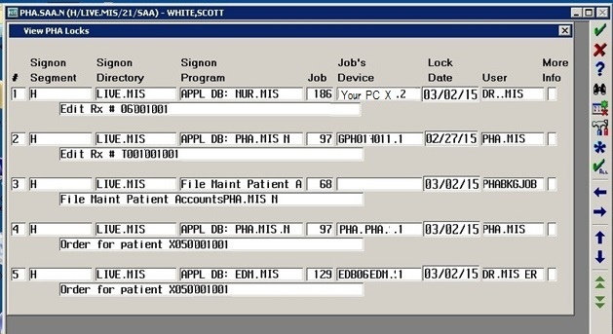
Pharmacy Locks List:
– The Pharmacy Locks List will show you valid/active locks created by users accessing the patient’s RX records via any of the integrated applications – PWM, PHA, RXM, NUR, POM, etc.. It also shows valid locks created by background jobs that transmit and update other tables within Meditech. However, if you trend this throughout the course of a day and compare the results of earlier scans, you will occasionally notice that some locks remain on this list for anywhere between 4 hrs and 4 days. Symptoms of problematic locks include irritation, stress, feelings of helplessness, and constipation …….oh wait, that’s the human toll side of it. Clinicians will be unable to access the records when needed and some background jobs will hang and become backed-up (constipated). This creates additional issues with the integrated apps. waiting for data to cross.
Article ID: 12863 Date: 1/2/2002 Published: 1/2/2002 | Application: PHA Subject: Locks Platform: MAGIC

Slide 15
Locks routine general concept:
– Use my checklist as a starting point and search through each of your applications to see if there are additional LOCK management routines sitting on a menu and waiting to be utilizeded.
– If you work your way through the locks routine within each application, you’ll notice that some of the locks you discover in your first application (ADM) can be traced through additional apps. and reveal details about who, where, and why a particular lock should either be left alone or cleared before someone needs to access that record.
Now, let’s begin walking through a few of the “frequent flyers” screens together.
(…….switching over to 50 page PDF of key screens & info)

