Slide 1
Evergreen Valley Technical Facility
Healthcare IT Support is now affordable

Slide 2
Evergreen Valley Technical Facility is a WOSB in upstate NY that was put into action in 2011 and formally recognized by the State of NY under the license of EVTF, LLC in 2014. With over 150 years of combined IT & Healthcare experience within our direct team, we also bring the full weight of all relevant IT services through our extended solutions partners. Doing so minimizes costs and maximizes value.
Clinicians need reliable IT systems so they can focus on what they do best- Provide quality care to each and every patient. Our products & services help accomplish this. We are well versed in addressing those “hiccups” as well as preventing them.
Our simple yet effective model makes it possible to keep costs well below industry standards while simultaneously delivering knowledgeable expertise to your organization the moment you need it. EVTF can help you address IT problems as well as proactively prevent them. Our customers enjoy a reduction of off-hours support issues by up to 50%.

Slide 3
Products & services
ONCC-Overnight Call Center- Live Healthcare IT support that answers the phone and works on your issue on the first call, with over 90% problem resolution. Not a call forwarding & paging service; but actual triage and resolution of most common support needs.
ASMM- Active Systems Monitoring &Maintenance-Proactive monitoring of Hospital systems to avoid problems with clinician work flow. This includes applications, interfaces, key SAN areas, VM environment and backups/IDR’s.
AMCC- Affordable Mobile Command Center-Guaranteed SLA’s to deliver robust mobile offices to provide appropriate on-site work space after a disaster and improve B.C/D.R. Risk Assessment Scores. Also used to perform annual testing & validation of your DR Plan.
DR_T_VAL- Disaster Recovery Test and Validation service- hospitals are required to test and validate their DR plans. We have decades of experience in successful DR testing, documentation, and Security Audit Reporting. EVTF provides full-cycle systems testing and comprehensive documentation which helps improve your B.C/D.R. Risk Assessment maturity Scores.

Slide 4
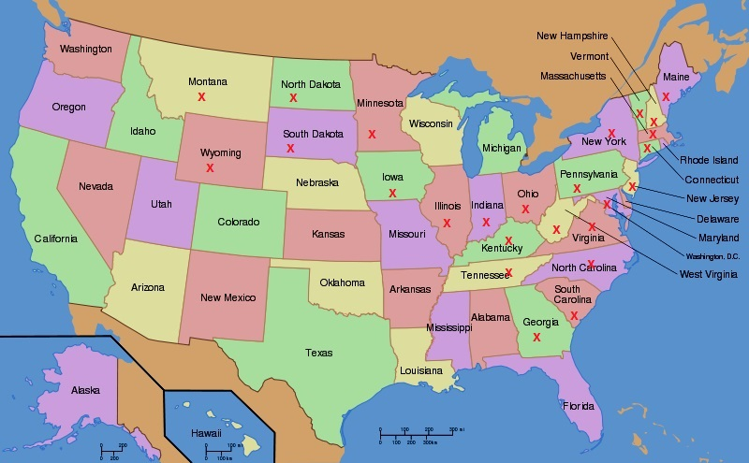
By the numbers
9,500- End-users supported by our services.
6,400- Hours provided to EVTF customers in past year (includes volunteer hrs).
816- Avg. # of ASMM events identified / mitigated per year.
50%- Avg. reduction of off hours support calls after 60 days of ASMM service.
38- Facilities covered by our ONCC & ASMM services.
25- States where AMCC has been used to support customers.

